Slide 1



Multi-Modal Integration Group
Literature Review
2d Lts Alex Milham and Connor Oswald
Air Force Institute of Technology
The views expressed in this presentation are those of the author(s) and do not reflect the official policy or position of the United States Air Force, the Department of Defense, or the United States Government.

Slide 2
Outline
Literature Tree
Summary of Important Metrics
Methods Table?

Slide 3
Pilot Retention Problem
Metrics
Pilot Training
Officer Attrition
Psychological/HRM
Economic
Enlisted Attrition
Jenkins et al.
Pujats
Zhao et al.
Franzen
Keller et al.
Johnson
Zimmermann
Mattock et al.
Elliot
Jantscher
Pujats
McGee
Mattock et al.
Trodahl
Salgado
Weiblen

Slide 4
Pilot Retention Problem Methodology
Logit
Survival Analysis
Feedforward NN
Recurrent NN
Qualitative Study
Linear Regression-esque
McGee
Weiblen
Johnson
Franzen
Franzen
Zimmermann
McGee
Mwaro et al.
Jenkins et al.*
Zhao et al.*
Faraggi and Simon
Raji and Vinrod
Pan et al.
Meng et al.
O'Donnell
Keller et al.
Mattock et al.
Trodahl
Salgado
Elliot
Jantscher
Pujats
McGee
Stanely III
*x = explored numerous other ML techniques

Slide 5
Highlights of Important Metrics
Mattock et al. describe how pilots leave due to low pay/lack of bonuses and incentives when compared to civilian airlines (even despite ARP and AP).
Also stress familial and work-life balance factors
Recommends significant increase of ARP cap for rapid response
Elliot used dynamic regression for attrition forecasting to deal with the peculiarities of time series data
Found unemployment rate lagged by 24 months as the only predictor significant in all models
Jantshcer explored economic metrics for numerous AFSCs via multiple regression analysis
For pilots, important negatively correlated predictors are: employment lagged by one year, GDP lagged two years, etc.
Positively correlated: unemployment rate lagged one year and youth unemployment lagged one year. NOTE: correlations were generally low (<0.4)

Slide 6
Highlights of Important Metrics
Trodahl examines important factors in naval pilot retention
Surveyed TACAIR aviators, found independent variables that relate with job satisfaction (fulfillment, nonflying duties, perceived support, etc.) to carry the most importance in deciding to stay in or leave the service.

Slide 7
Machine Learning Related Articles
Jenkins et al.
Applied various ML techniques to pilot training data, found ensemble tree methods and NN had highest accuracy. Also is a good reference for synthetic minority oversampling technique (SMOTE)
Zhao et al.
Similar to above article, applies a wide variety of ML techniques (9 in total including tree/ensemble techniques, gradient boosting methods, LR, LDA, Naïve Bayes, and KNN). Performs analysis on small, medium, and large employee retention data. Tree based methods (XGB) again performed the best on average, followed by NN.
Also includes feature importance plot

Slide 8
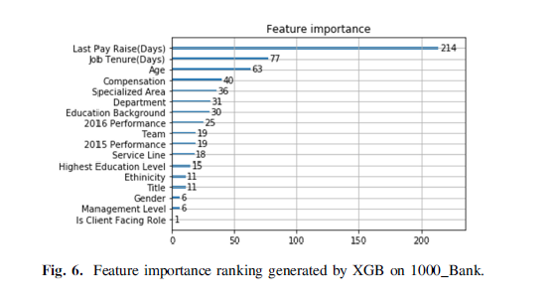
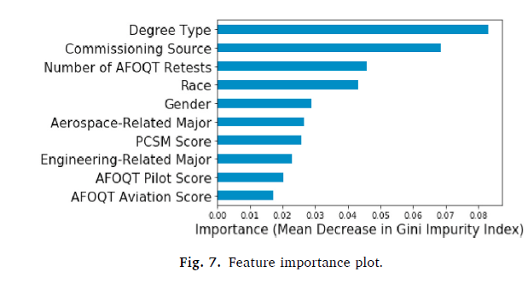
Machine Learning Related Articles

Slide 9
General AF Retention
McGee analyzes AF Officer retention through a macroeconomic lens
Ties AF personnel data to several leading economic indicators (new orders for durable goods, Consumer Confidence Index (CCI), new business formations), lagged by 12 months and ran logistic regression to predict retention.
Found that new business formations and durable goods orders were good indicators to predict a decline in retention in officers.
Resulting model was able to accurately predict retention rates for 9 AFSC’s (pilots included)
Weiblen studies how deployments or lack of them effects retention of O1-O3
Utilizes logistic regression in combination with job satisfaction survey data to predict retention 3 years after a deployment for 5 career categories
Found deployment not significant, but males, married servicemembers, those not commissioned from ROTC, and careers outside of Ops more likely to retain

Slide 10
Enlisted Retention (EOD)
Johnson uses logistic regression to determine factors leading to the decline of the enlisted EOD force, specifically whether a servicemember will complete 1, 2, or more enlistments
Found that for first enlistment: not making SSgt, being single, and not deploying significantly reduced retention
For second enlistment: not making TSgt, being younger than 31, and having earned a degree reduced retention
Describes two factors that ultimately appear to affect servicemembers decisions: Job satisfaction, continuance commitment (costs of leaving/staying in the AF).

Slide 11
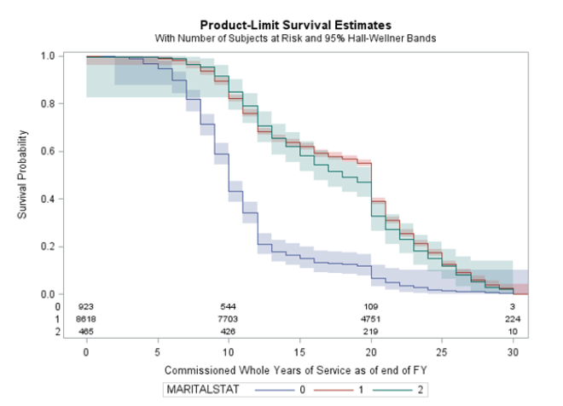
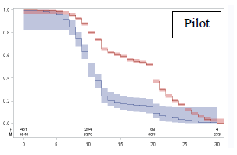
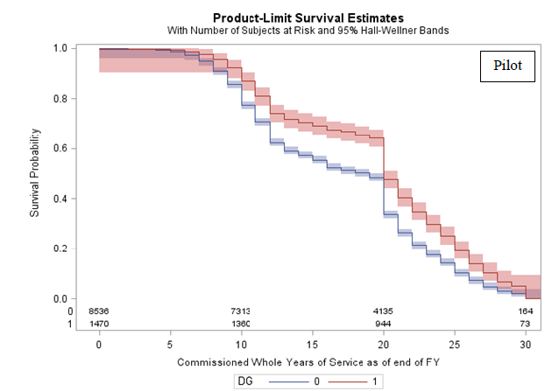
Rated Officer Survival Analysis
Franzen utilizes Logistic Regression and Survival analysis to study rated officer retention rates
Analyzes demographic, economic and political (Perstempo, male to female ratio) data
Includes analysis of factors not seen elsewhere (DG from commissioning source, prior service)
Finds males, prior service, DG’s, and those with dependents are more likely to retain
Recommends further study for pilots based on air-frame

Slide 12
Qualitative Study of Higher Female Attrition
Keller et al. address the high female attrition rate in the AF Officer Corp via a qualitative study, identifying key factors
Conducted focus groups at various bases around the country
Identified four problem areas that lead females to separate:
Family/personal issues (childcare, spousal issues)
Career issues (slower promotion/ less opportunity)
Work environment (sexual harassment/assault, work/life balance)
Broader AF Issues (PCS, deployments)

Slide 13
Ensemble Neural Net
Mwaro et al. use a set of three shallow neural nets to perform binary classification.
Employer perspective (do we promote somebody or put them on a performance plan).
Several highly subjective performance metrics as features (quality of work, communication skills, initiative, creativity, integrity, client relation)
Utilize bootstrapping to create subsets of training data, then train three single-hidden-layer NN's on the data.
Use consensus of the three nets for prediction, achieving an overall 95% accuracy.

Slide 14
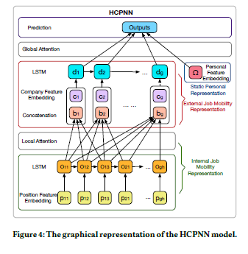
Career-Path-Aware NN
Meng et al. create a model that accounts for general career progression trends for predicting how long an employee will stay in a new position
Use employee-specific, company-specific, and position-specific factors.
Analyzes sequences of employee positions to predict an employee's next employer as well as the duration of time they will remain there.
Could be parallelized to match Air Force Pilot progression
Analyze career path of pilots as an indicator of attrition?

Slide 15
Time Series for AF Retention
O'Donnell follows up McGee's research, taking an RNN approach to predict retention for various Officer Career Fields
Compares autoregressive integrated moving average (ARIMA) model, RNN using Gated Recurrent Units (GRU), and RNN using Long Short-Term Memory (LSTM)
Uses CCI, New Durable Goods orders, and New Business Formations for economic considerations
Used a relatively limited training set (124 observations)
ARIMA model found to be most successful overall, but GRU RNN had lowest RMSE for Pilot career field.

Slide 16
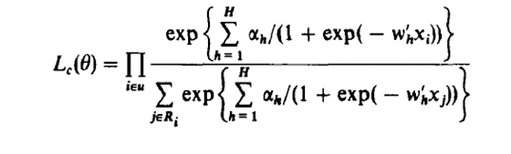
Neural Networks Applied to Survival Data
A Neural Network Model For Survival Data (Faraggi and Simon)
"Grandfather" proof-of-concept article. Dataset included stage 3 and 4 prostatic cancer patients (~500 observations with 50/50 split)
Two-layer NN with two and three hidden neurons. Newton-Raphson method used for backpropagation
Utilized concordance [c] statistic and log likelihood ratios to assess goodness of fit
Overall, the NNs performed comparably to contemporary techniques (PH models)

Slide 17
Neural Networks Applied to Survival Data
Graft Survival Prediction in Liver Transplantation using Artificial Neural Network Models (Raji, Vinrod)
Filtered data included observations from 299 donor males and 154 female donors (243 recipient survived out of 383)
Data contained info both on the liver to be transplants (chemical levels, etc.) and recipient info (BMI, age)
Three-layer structure, 27 hidden neurons
Used 10-fold CV to assess, achieved ~99% accuracy.
Pretransplant Prediction of Posttransplant Survival for Liver Recipients with Benign End-Stage Liver Diseases: A Nonlinear Model (Zhang et al.)
Suspect article (Pretransplant Prediction of Posttransplant Survival for Liver Recipients with Benign End-Stage Liver Diseases: A Nonlinear Model | PLOS ONE)
Employed two-layer NN with 12 HN to predict liver transplant recipients' survival after a year and two years.
360 observations, 89 died over 5 year follow up period

Slide 18
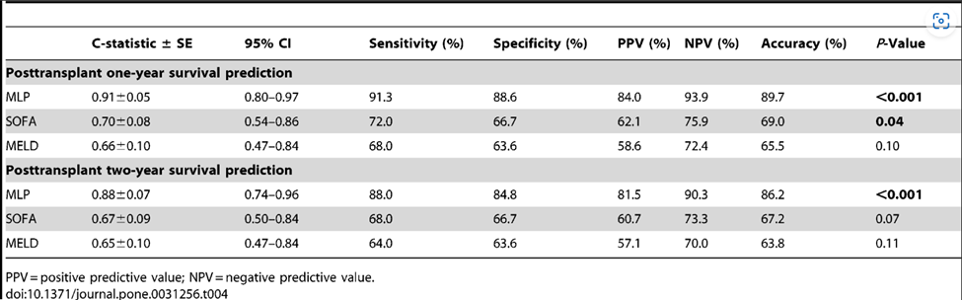
Neural Networks Applied to Survival Data
Pretransplant Prediction of Posttransplant Survival for Liver Recipients with Benign End-Stage Liver Diseases: A Nonlinear Model (Zhang et al.)
In clinical studies, the C-statistic gives the probability a randomly selected patient who experienced an event (e.g. a disease or condition) had a higher risk score than a patient who had not experienced the event (Statisticshowto.com)

Slide 19
Neural Networks Applied to Survival Data
Survival Prediction for Oral Tongue Cancer Patients via Probabilistic Genetic Algorithm Optimized Neural Network Models (Pan et al.)
Employed three neural network models, including back propagation (BP), Genetic Algorithm-Back Propagation (GA-BP), and Probabilistic Genetic Algorithm-Back Propagation (PGA-BP) neural networks to simulate association between patient survival and radiomics data in radiotherapy
Data was comprised of imaged initially distilled to >1000 features
Used novel t-Distributed Stochastic Neighbor Embedding (t-SNE) algorithm for non-linear dimensionality reduction and PCA for dimensionality reduction
Basic 2-layer BP neural network structure was used, and the number of input layer nodes, the hidden layer nodes and output nodes are 159, 25 and 1, respectively. t-SNE PGA-BP model worked best.
T-tests performed between short and long survival patients to identify salient image features

Slide 20
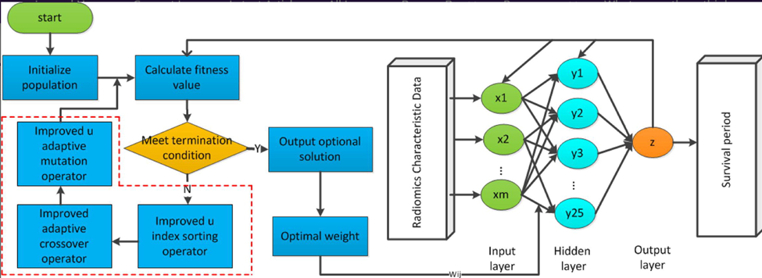
Neural Networks Applied to Survival Data
Survival Prediction for Oral Tongue Cancer Patients via Probabilistic Genetic Algorithm Optimized Neural Network Models (Pan et al.)

Slide 21
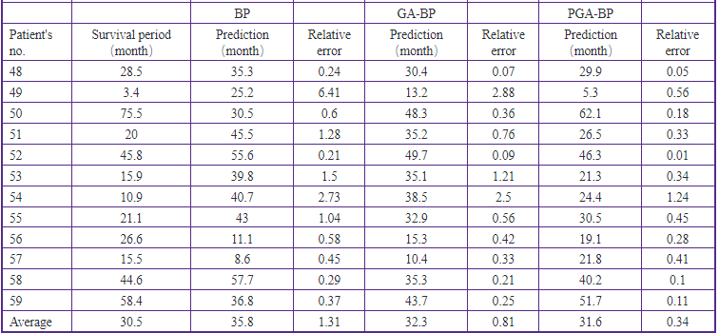
Neural Networks Applied to Survival Data
Survival Prediction for Oral Tongue Cancer Patients via Probabilistic Genetic Algorithm Optimized Neural Network Models (Pan et al.)

